Slide 1


Club Runner
Rotary Club of Emerald & District
2023-2024

Slide 2
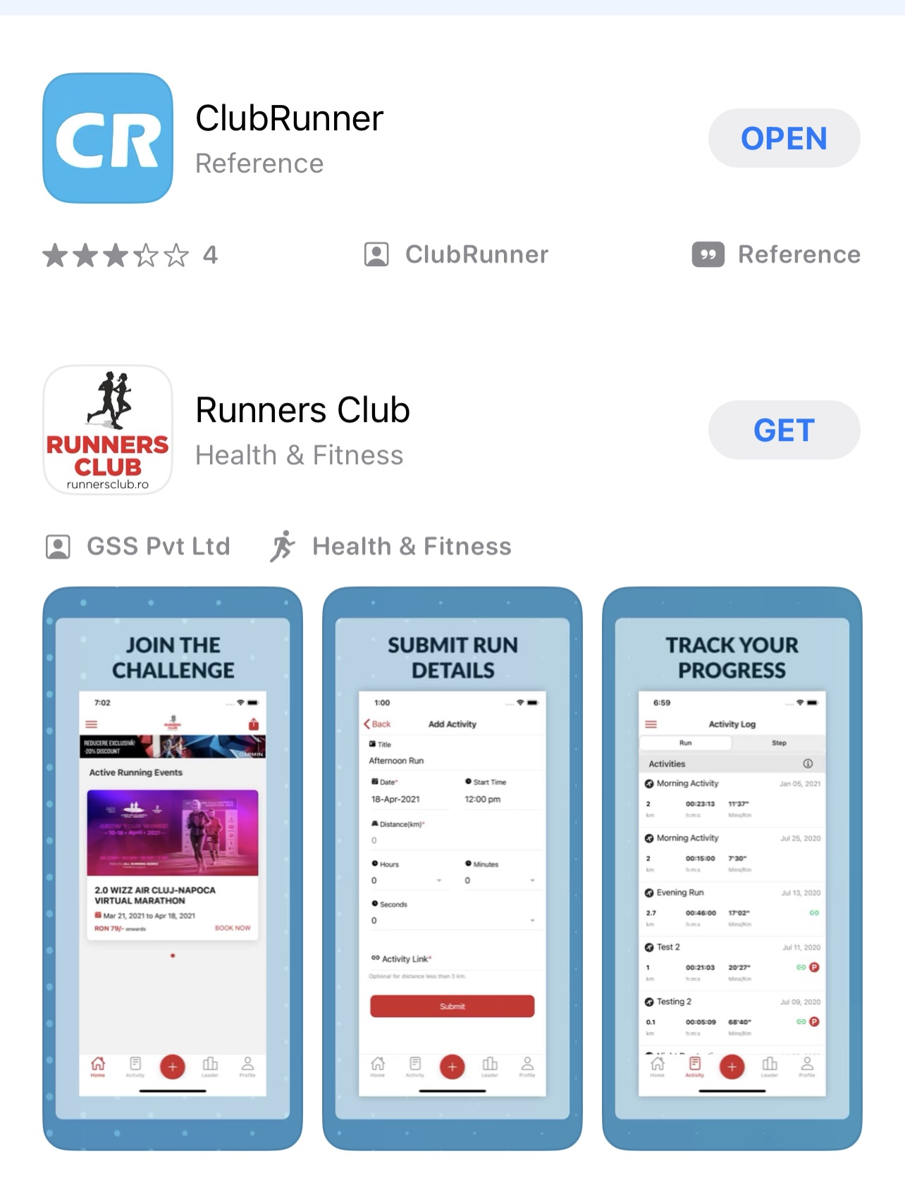
Your App
In the App Store
No cost

Slide 3
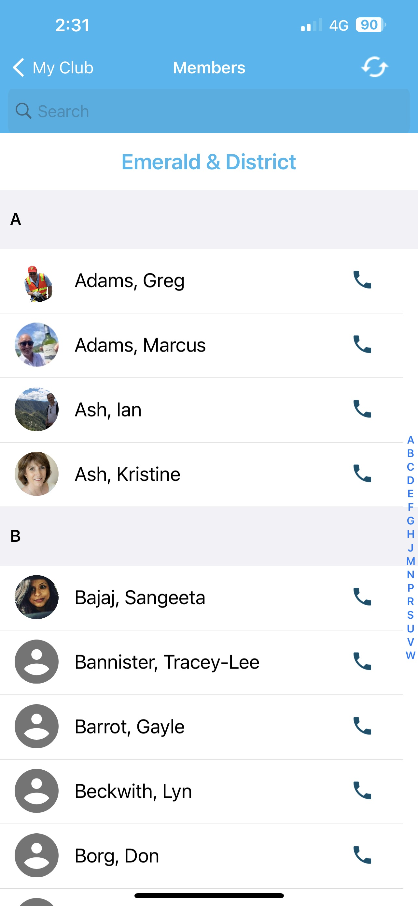
Club Contacts
Click on telephone to call directly from phone
Click on name for other details
Email link to email from phone

Slide 4
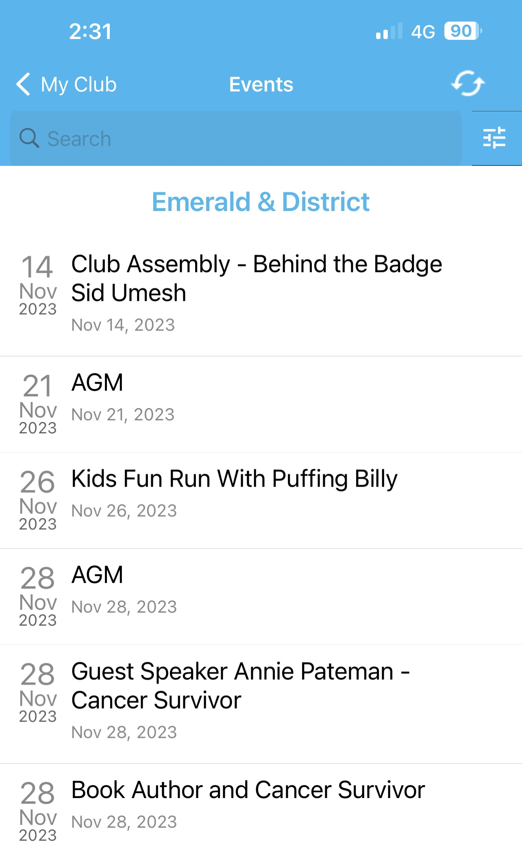
Event Summary
All up-coming events at your fingertips

Slide 5

Our Website
Our website is a great source of information on club and community news.
This is regularly updated after Board Meetings to provide information on committee activities.
Our signature event pages provide information on dates, venues etc.
https://www.emeraldrotary.org.au/

Slide 6
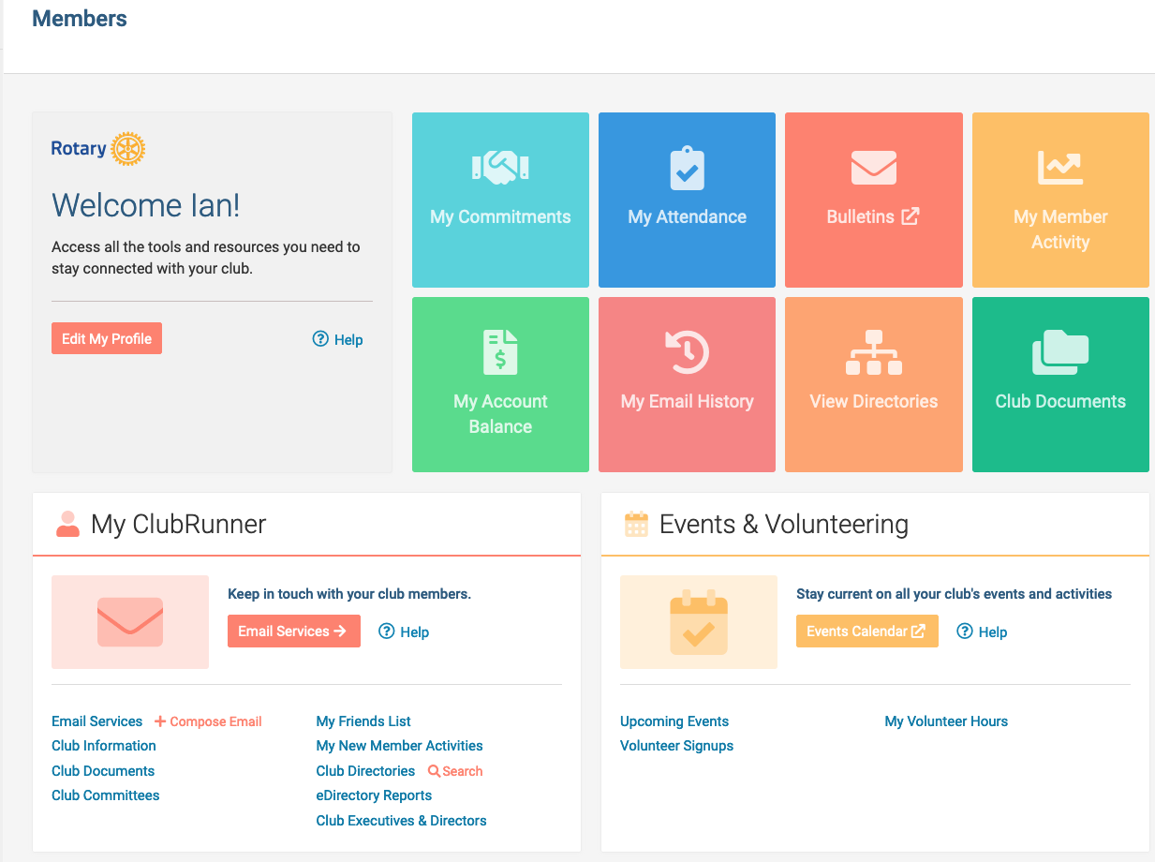


Club Runner
Membership Portal
Via our website & enter
Username
Password

Slide 7
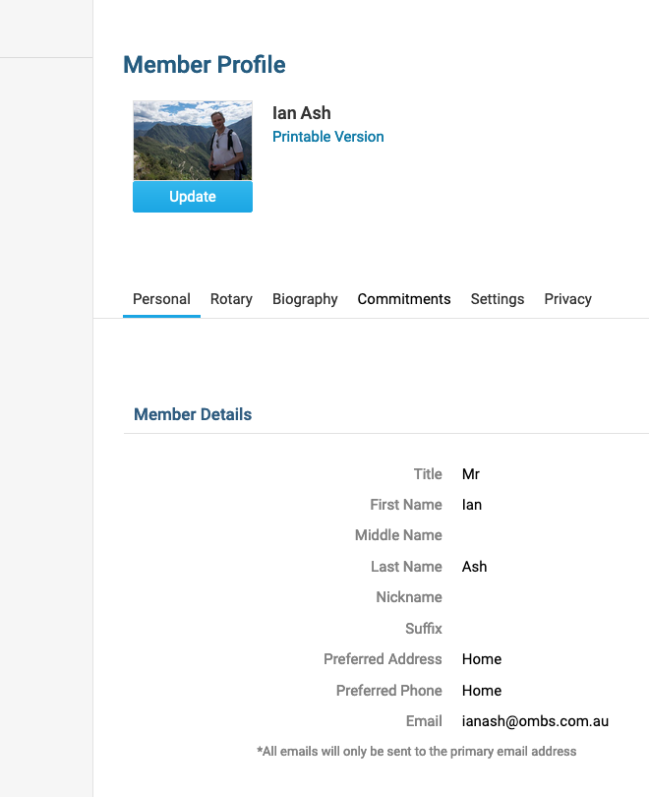
Your Profile
Username
Password
Personal Details
Biography

Slide 8
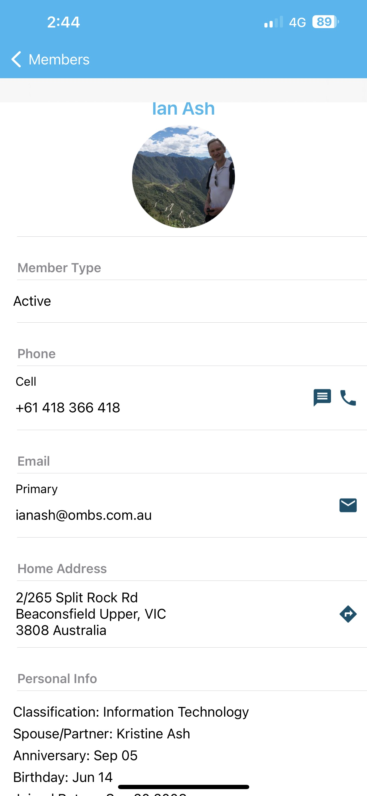
Take control of your detail
Spouse birthday not noted???
You have the power to add this!!

Slide 9


My Rotary https://www.rotary.org/en using your login and password there is a world of Rotary Information to absorb at your leisure!

Slide 10


Questions??

