Slide 1

MAROONDAH ADULT MENTAL HEALTH IPU CARE PACK PROJECT
ROTARY CLUB OF LILYDALE

Slide 2
Community Service: building communities and promoting acts of kindness

Slide 3
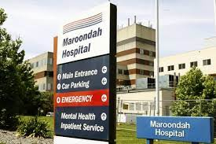
Maroondah Mental Health IPU

Slide 4
1460
Number of inpatients per year:
Two IPU:
For every discharge, a new inpatient is admitted
2 out 2 in / 365 days a year

Slide 5
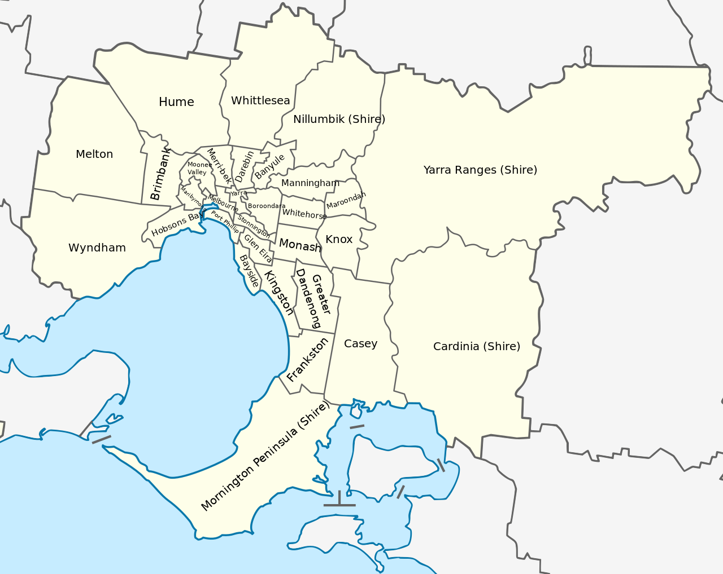

Slide 6
Care pack Contents
Public Health Service Provide
Basic personal grooming & Period care
OUT
Alcohol
Hard or Sharp objects
Long straps

Slide 7

Care pack Contents
IN
Grooming
Treats
Activities
Wishlist
Clothes (inc. underwear and footwear)
Craft Supplies
“Spa Day” supplies
Soccer Balls / Basketballs
Discharge Bags

Slide 8
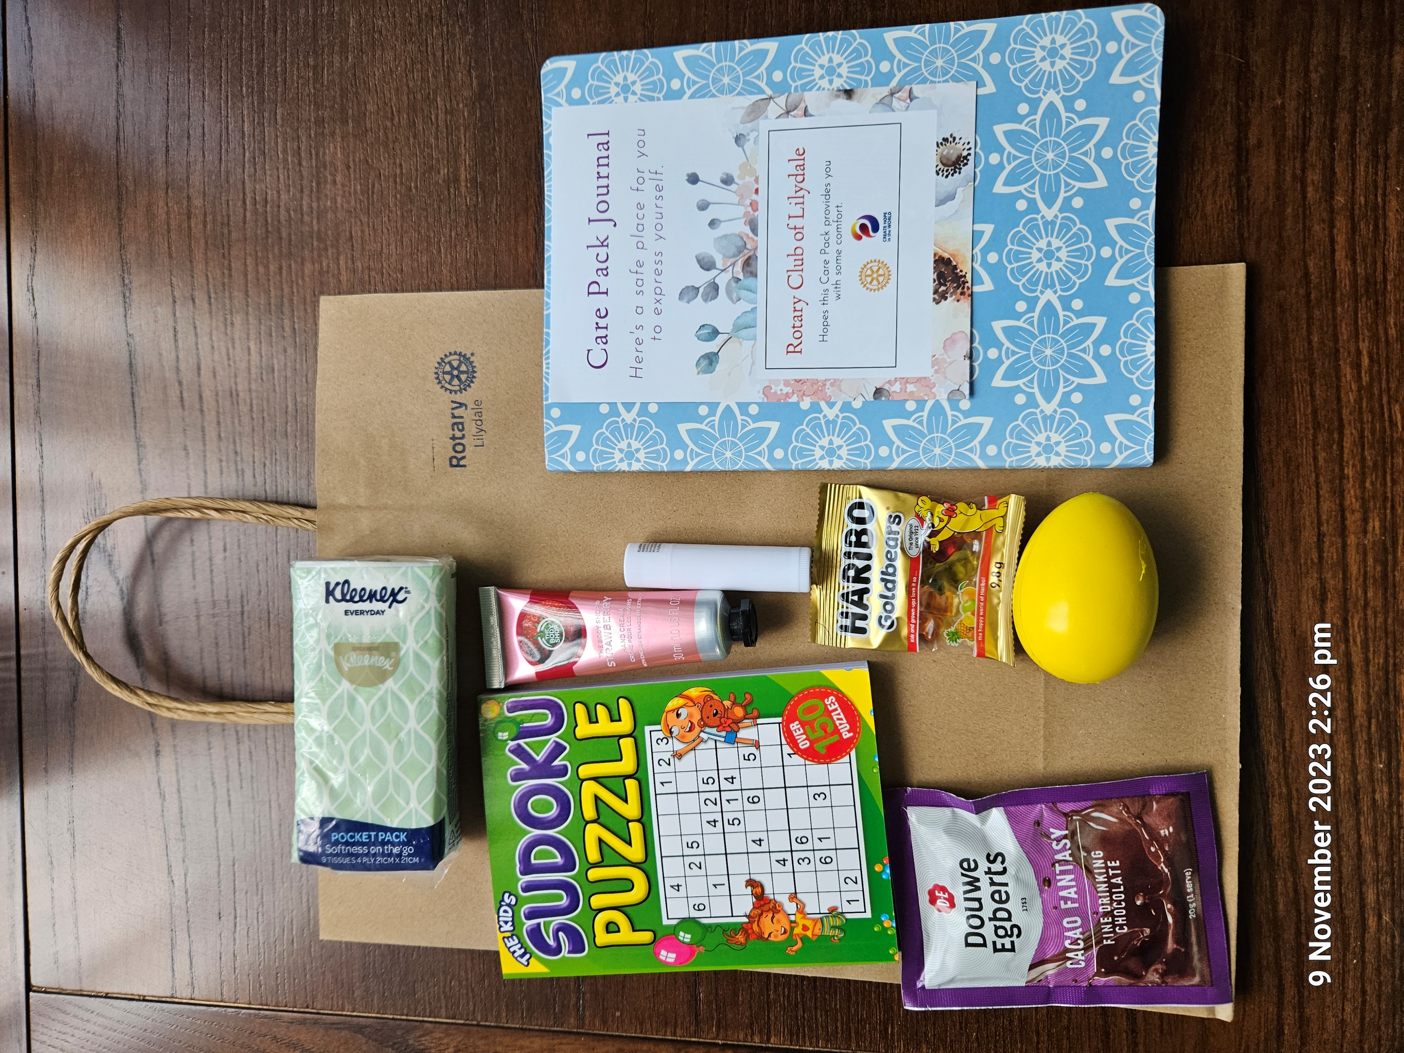

Slide 9
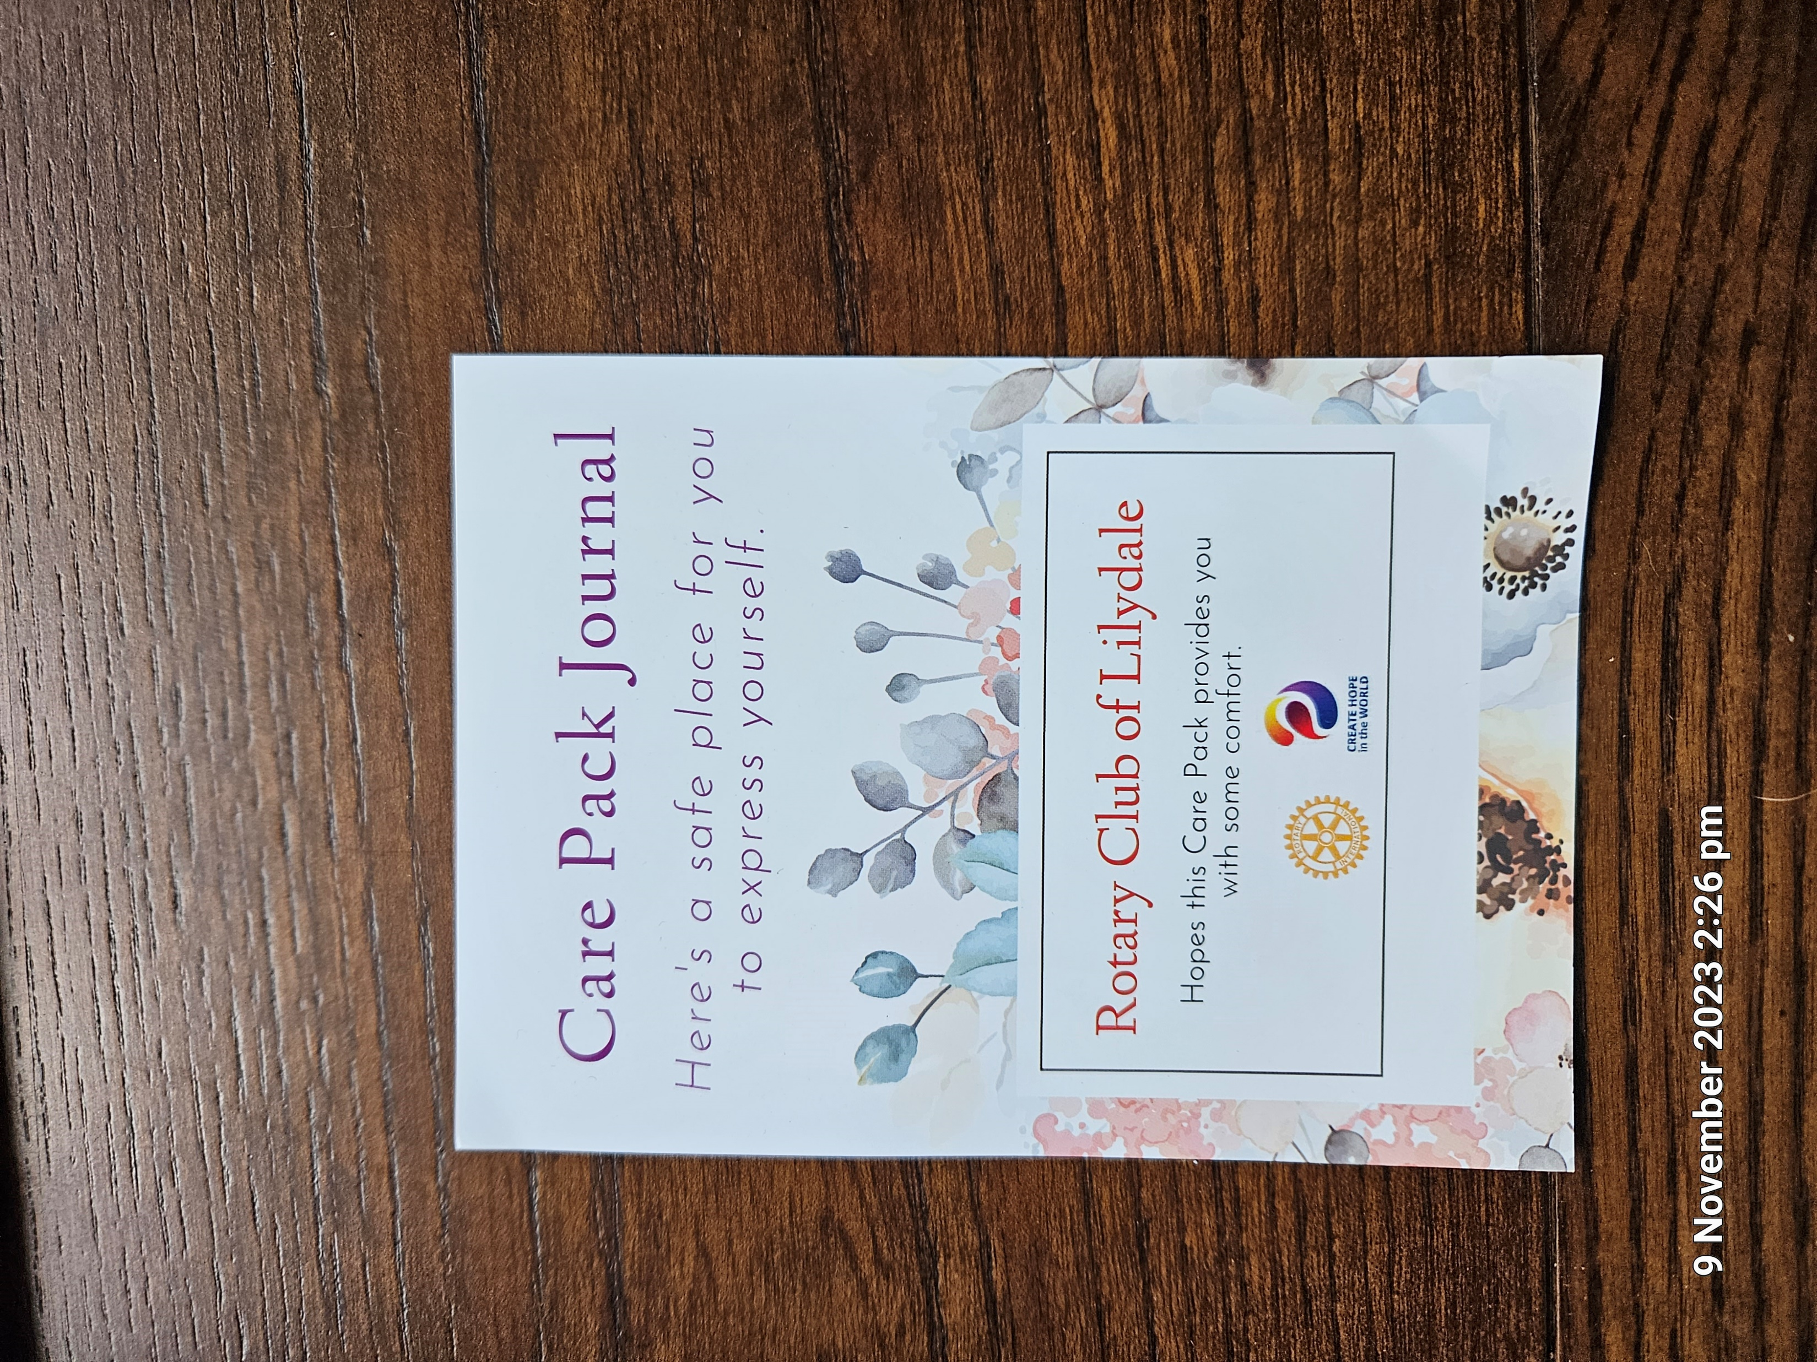

Slide 10
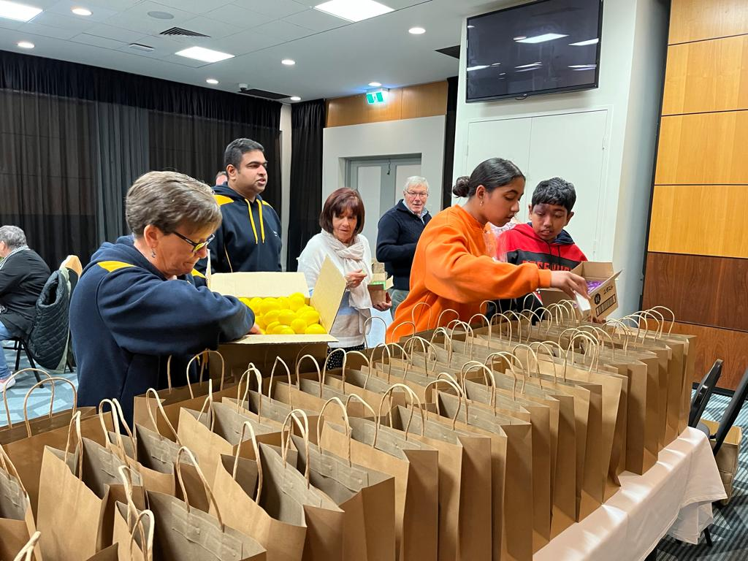
Packing night

Slide 11
$10K per annum project as at Nov 2023

Slide 12
= Successful Project
Project Team Skills:
Project Management
Time Management
Business Writing
Influence and Negotiation
Excel (basic) and
Savvy Shopper
Club Member involvement:
Purchasing & Pick up
Preparation & Storage
Car packing & Delivery
Promoting It’s Time Raffle

Slide 13
S
Dedicated Project Leader
W
T
Club Funding withdrawn
O
Increase promotion of the Rotary Brand
Increase in costs (CPI)
Experience of three deliveries = continuous improvement
Distributor/Supplier issues
Sample letters, spreadsheets, accounts with suppliers established
Other Clubs in LGA to join to spread the costs and be involved in community project
Storage and delivery
Availability of Lilydale Members to collect, prepare and deliver items
Packing & delivery
Health & Safety

Slide 14
14
“Research shows that performing acts of kindness is the most effective way to protect our own sense of well-being and become more resilient.”
Rotary International President, R. Gordon R. McInally
https://my.rotary.org/en/who-we-are/office-of-the-president/presidential-initiatives 27 September 2023

Slide 15
Dedicated Project Leader
Clubs in Knox, Maroondah & Yarra Ranges LGA contributing costs of (one or) two months of Care Packs
Same Clubs supporting the project through:
Purchasing & Pick up
Storage & Preparation
Car packing & Delivery to IPU
=
Successful ONGOING District 9815 Project

Slide 16
Project Funding ongoing
$1650 COMMITMENT FROM FIVE ADDITIONAL CLUBS per annum*

Slide 18

QUESTIONS

